Slide 1
Learning Objective
I will be able to solve problems involving independent events.
Success Criteria
At the end of the lesson, I will be able to:
Identify an independent set of events based on an independence test.
Construct and use two-way tables or Venn diagrams to solve problems involving independent events.

Slide 2
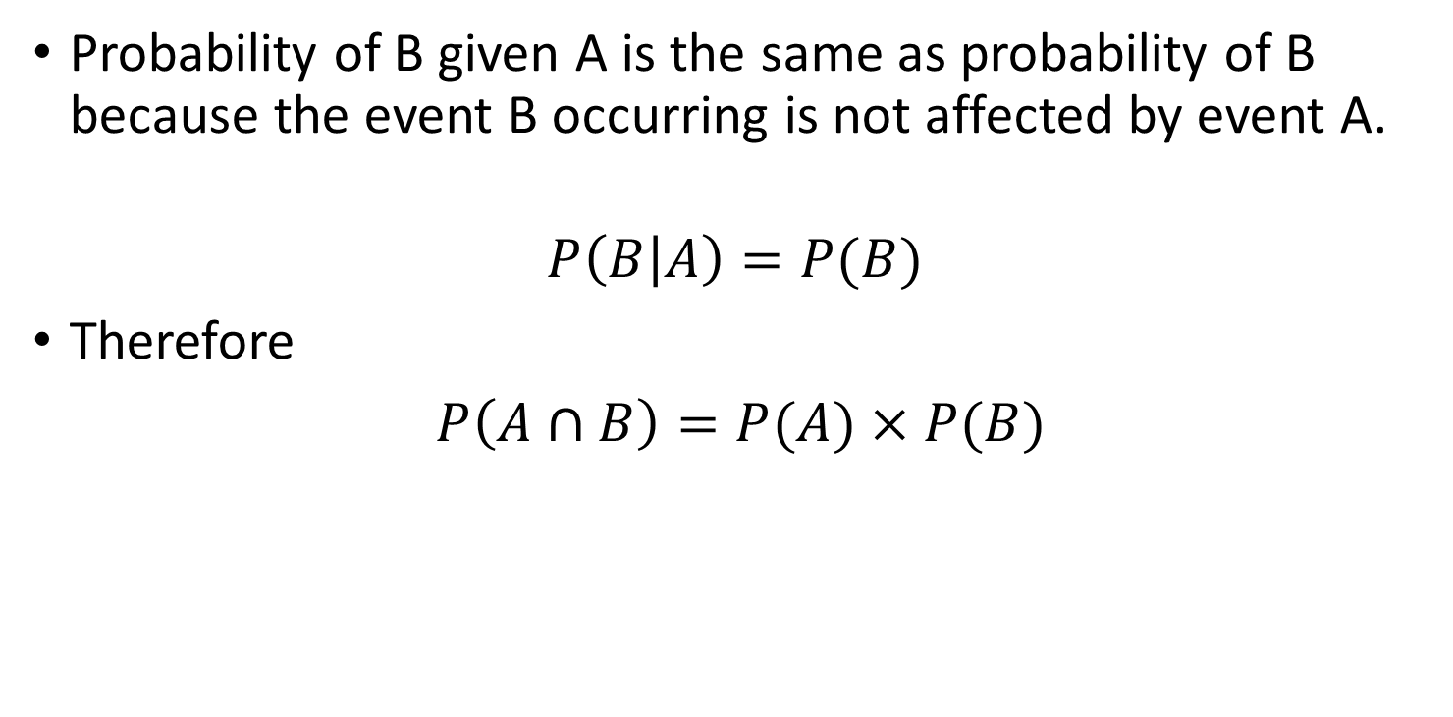
For any 2 independent events A & B
Concept Development
Probability of B given A is the same as probability of B because the event B occurring is not affected by event A.
$$P\left(B | A\right)=P(B)$$
Therefore
$P\left(A∩B\right)=P(A)×P(B)$

Slide 3
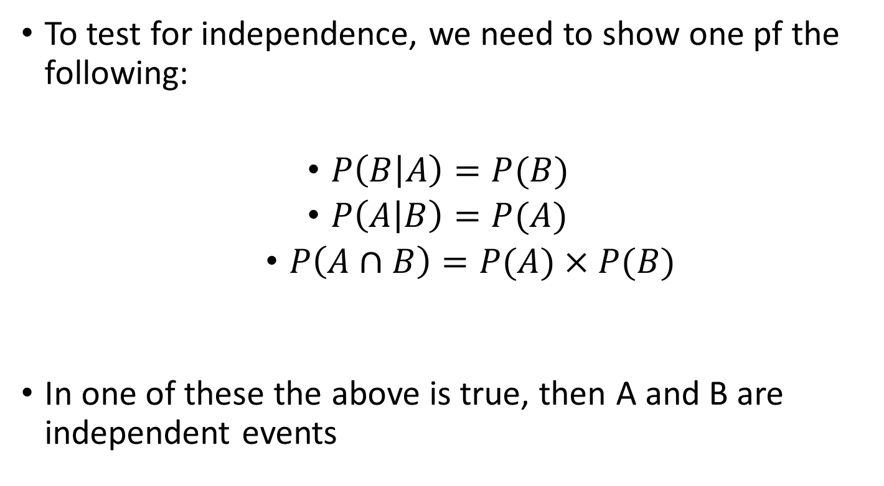
Test for independence
Concept Development
To test for independence, we need to show one pf the following:
$P\left(B | A\right)=P(B)$
$P\left(A | B\right)=P(A)$
$P\left(A∩B\right)=P(A)×P(B)$
In one of these the above is true, then A and B are independent events

Slide 4
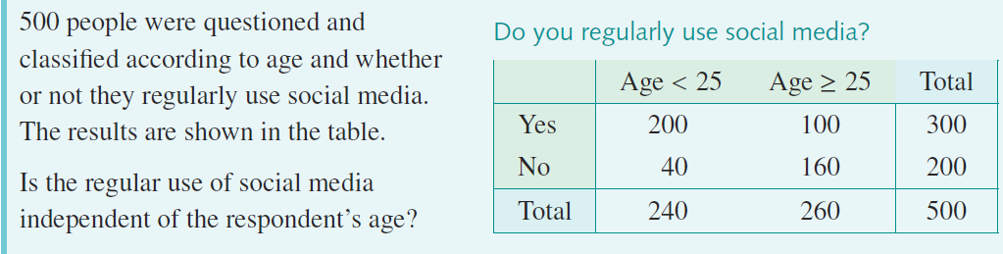



Guided Practice
Independent Proof: $P\left(A∩B\right)=P\left(A\right)×P(B)$
$P\left(Yes∩<25\right)=\frac{200}{500}=\frac{2}{5}$
$P\left(Yes\right)=\frac{300}{500}=\frac{3}{5}$
$P\left(<25\right)=\frac{240}{500}=\frac{12}{25}$
$P\left(Yes\right)×P\left(<25\right)=\frac{3}{5}×\frac{12}{25}=\frac{36}{125}$
$P\left(Yes∩<25\right)≠P\left(Yes\right)×P\left(<25\right)$
$∴$ the events are not independent

Slide 5
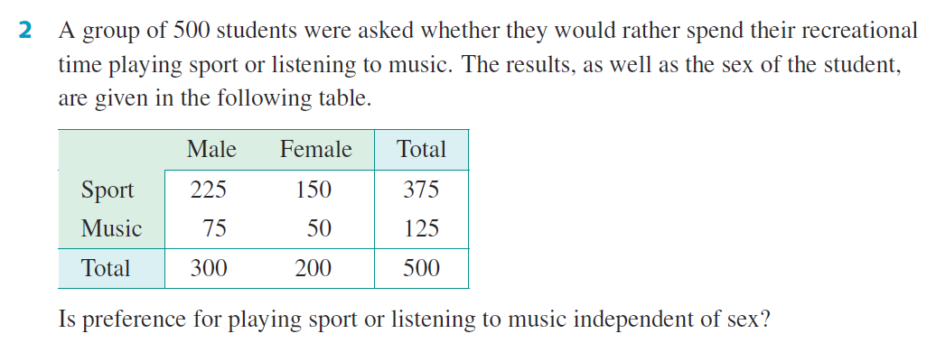




Guided Practice
$P\left(S\right)=\frac{375}{500}=\frac{3}{4}$
$P\left(Males\right)=\frac{300}{500}=\frac{3}{5}$
$P\left(S∩Males\right)=\frac{225}{500}=\frac{9}{20}$
$P\left(S\right)×P\left(Males\right)=\frac{3}{4}×\frac{3}{5}=\frac{9}{20}$
$$P\left(S∩Males\right)=P\left(S\right)×P\left(Males\right)$$
$∴$ Yes the events are independent

Slide 6
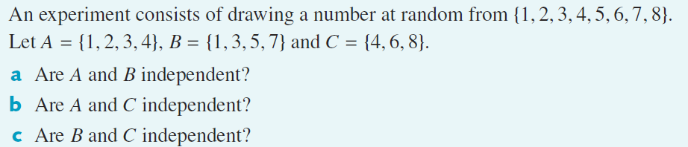
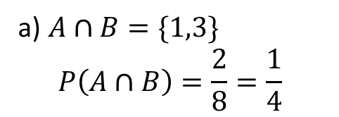



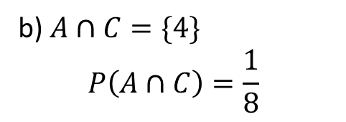

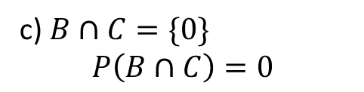








Guided Practice
$P\left(A\right)=\frac{4}{8}=\frac{1}{2}$
$P\left(B\right)=\frac{4}{8}=\frac{1}{2}$
$P\left(C\right)=\frac{3}{8}$
a) $A∩B=\{1,3\}$ $$P\left(A∩B\right)=\frac{2}{8}=\frac{1}{4}$$
b) $A∩C=\{4\}$ $$P\left(A∩C\right)=\frac{1}{8}$$
c) $B∩C=\{0\}$ $$P\left(B∩C\right)=0$$
$P\left(A\right)×P\left(C\right)=\frac{1}{2}×\frac{3}{8}=\frac{3}{16}$
$P\left(B\right)×P\left(C\right)=\frac{1}{2}×\frac{3}{8}=\frac{3}{16}$
$P\left(A\right)×P\left(B\right)=\frac{1}{2}×\frac{1}{2}=\frac{1}{4}$
$$P\left(A∩B\right)=P\left(A\right)×P\left(B\right)$$
$$P\left(B∩C\right)≠P\left(B\right)×P\left(C\right)$$
$$P\left(A∩C\right)≠P\left(A\right)×P\left(C\right)$$
$∴$ Events A and B are independent
$∴$ Events A and C are not independent
$∴$ Events B and C are not independent

Slide 7
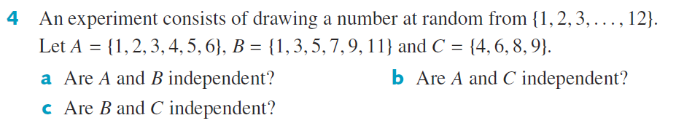

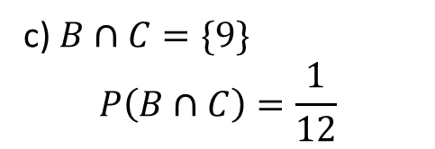






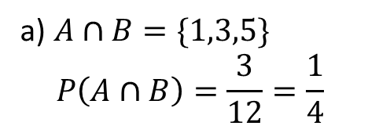


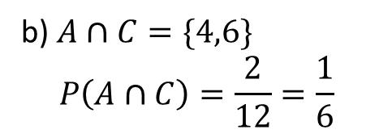
Guided Practice
$P\left(A\right)=\frac{6}{12}=\frac{1}{2}$
$P\left(B\right)=\frac{6}{12}=\frac{1}{2}$
$P\left(C\right)=\frac{4}{12}=\frac{1}{3}$
a) $A∩B=\{1,3,5\}$ $$P\left(A∩B\right)=\frac{3}{12}=\frac{1}{4}$$
b) $A∩C=\{4,6\}$ $$P\left(A∩C\right)=\frac{2}{12}=\frac{1}{6}$$
c) $B∩C=\{9\}$ $$P\left(B∩C\right)=\frac{1}{12}$$
$P\left(A\right)×P\left(B\right)=\frac{1}{2}×\frac{1}{2}=\frac{1}{4}$
$P\left(A\right)×P\left(C\right)=\frac{1}{2}×\frac{1}{3}=\frac{1}{6}$
$P\left(B\right)×P\left(C\right)=\frac{1}{2}×\frac{1}{3}=\frac{1}{6}$
$$P\left(A∩B\right)=P\left(A\right)×P\left(B\right)$$
$$P\left(A∩C\right)=P\left(A\right)×P\left(C\right)$$
$∴$ Events A and C are independent
$$P\left(B∩C\right)≠P\left(B\right)×P\left(C\right)$$
$∴$ Events A and B are independent
$∴$ Events B and C are not independent

Slide 8
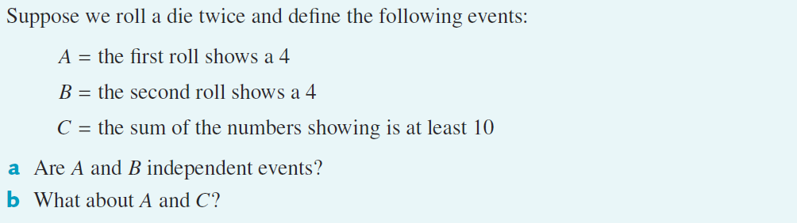











Guided Practice
$P\left(A\right)=\frac{6}{36}=\frac{1}{6}$
$P\left(B\right)=\frac{6}{36}=\frac{1}{6}$
$P\left(C\right)=\frac{6}{36}=\frac{1}{6}$
$$P\left(A∩B\right)=\frac{1}{36}$$
$P\left(A\right)×P\left(B\right)=\frac{1}{6}×\frac{1}{6}=\frac{1}{36}$
 | 1 | 2 | 3 | 4 | 5 | 6
1 | (1,1) | (1,2) | (1,3) | (1,4) | (1,5) | (1,6)
2 | (2,1) | (2,2) | (2,3) | (2,4) | (2,5) | (2,6)
3 | (3,1) | (3,2) | (3,3) | (3,4) | (3,5) | (3,6)
4 | (4,1) | (4,2) | (4,3) | (4,4) | (4,5) | (4,6)
5 | (5,1) | (5,2) | (5,3) | (5,4) | (5,5) | (5,6)
6 | (6,1) | (6,2) | (6,3) | (6,4) | (6,5) | (6,6)
$$P\left(A∩B\right)=P\left(A\right)×P\left(B\right)$$
$∴$ Events A and B are independent
b)$P\left(A∩C\right)=\frac{1}{36}$
$P\left(A\right)×P\left(C\right)=\frac{1}{6}×\frac{1}{6}=\frac{1}{36}$
$$P\left(A∩C\right)=P\left(A\right)×P\left(C\right)$$
$∴$ Events A and C are independent

Slide 9

Guided Practice
$P\left(A\right)×P\left(B\right)=0.3×0.1=0.03$
$$P\left(A∩B\right)≠P\left(A\right)×P\left(B\right)$$
$∴$ Events A and B are not independent

Slide 10
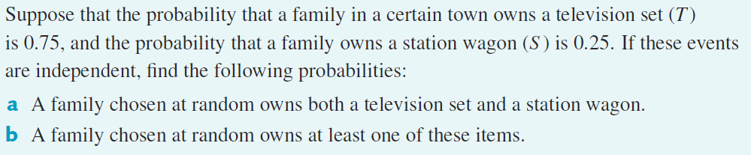











Guided Practice
$P\left(T\right)=0.75$
$P\left(S\right)=0.25$
a) $P\left(T∩S\right)=P\left(T\right)×P\left(S\right)$
$$=0.75×0.25=0.1875$$
b) $P\left(T∪S\right)=P\left(T\right)+P\left(S\right)−P\left(T∩S\right)$
$$=0.75+0.25−0.1875$$
$$=0.8125$$

Slide 11
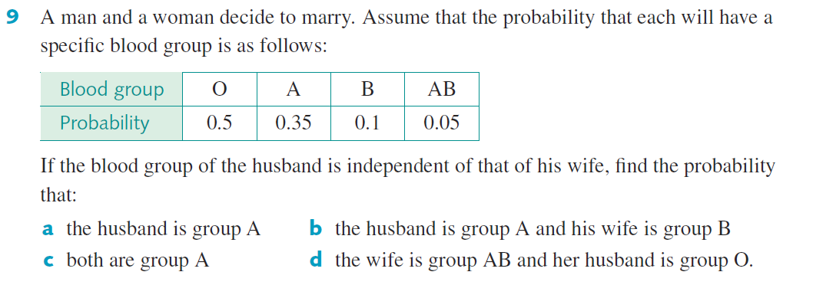










Guided Practice
a) $P\left(A\right)=0.35$
c) $P\left(A∩A\right)=P\left(A\right)×P\left(A\right)$
b) $P\left(A∩B\right)=P\left(A\right)×P\left(B\right)$
$$=0.35×0.35$$
$$=0.35×0.1$$
$$=0.1225$$
$$=0.035$$
d) $P\left(AB∩O\right)=P\left(AB\right)×P\left(O\right)$
$$=0.05×0.5$$
$$=0.025$$

Slide 12
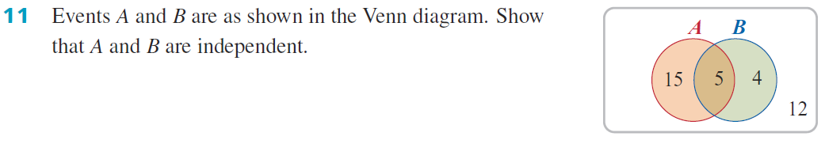



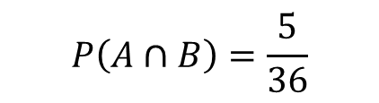
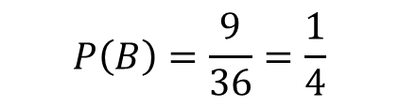
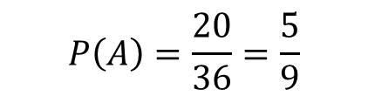
Guided Practice
$$n\left(U\right)=15+5+4+12=36$$
$$P\left(A\right)=\frac{20}{36}=\frac{5}{9}$$
$$P\left(B\right)=\frac{9}{36}=\frac{1}{4}$$
$$P\left(A∩B\right)=\frac{5}{36}$$
$P\left(A\right)×P\left(B\right)=\frac{5}{9}×\frac{1}{4}=\frac{5}{36}$
$$P\left(A∩B\right)=P\left(A\right)×P\left(B\right)$$
$∴$ Events A and B are independent

Slide 13
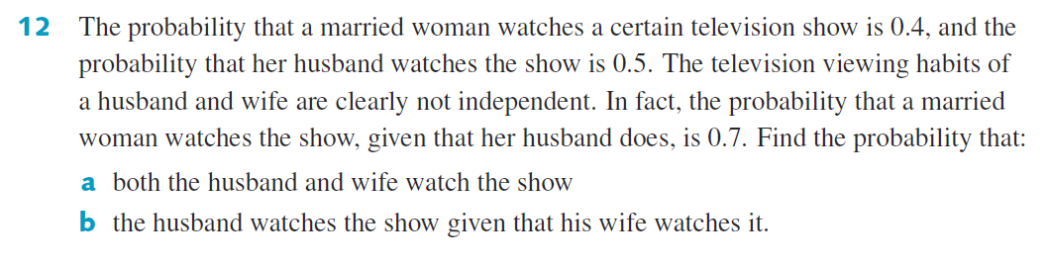









Guided Practice
$P\left(W\right)=0.4$
a) $P\left(W|M\right)=\frac{P\left(W∩M\right)}{P\left(M\right)}$
b) $P\left(M|W\right)=\frac{P\left(M∩W\right)}{P\left(W\right)}$
$P\left(M\right)=0.5$
$$=\frac{0.35}{0.4}$$
$P\left(W∩M\right)=P\left(W | M\right)P(M)$
$P\left(W|M\right)=0.7$
$P\left(W∩M\right)=0.7×0.5=0.35$
$$=\frac{35}{40}=\frac{7}{8}=0.875$$

Slide 14
Independent Practice
Complete Ex 9G

